Slide 1
Textile Sales Analysis

Slide 2
Description
Therma Tales Clothing Company prides themselves on providing an optimized range of clothing and lifestyle wear for the modern adventurer. Analyze their sales performance and generate a basic financial report to share with the wider business.
Analyze following questions :
What was the total quantity sold for all products?
What is the total generated revenue for all products before discounts?
What was the total discount amount for all products?
How many unique transactions were there?
What are the average unique products purchased in each transaction?
What is the average discount value per transaction?
What is the average revenue for member transactions and non-member transactions?
What are the top 3 products by total revenue before discount?
What are the total quantity, revenue and discount for each segment?
What is the top selling product for each segment?
What are the total quantity, revenue and discount for each category?
What is the top selling product for each category?

Slide 3
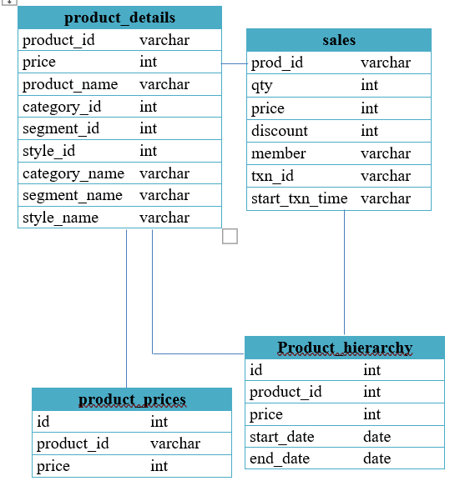
Schema

Slide 4
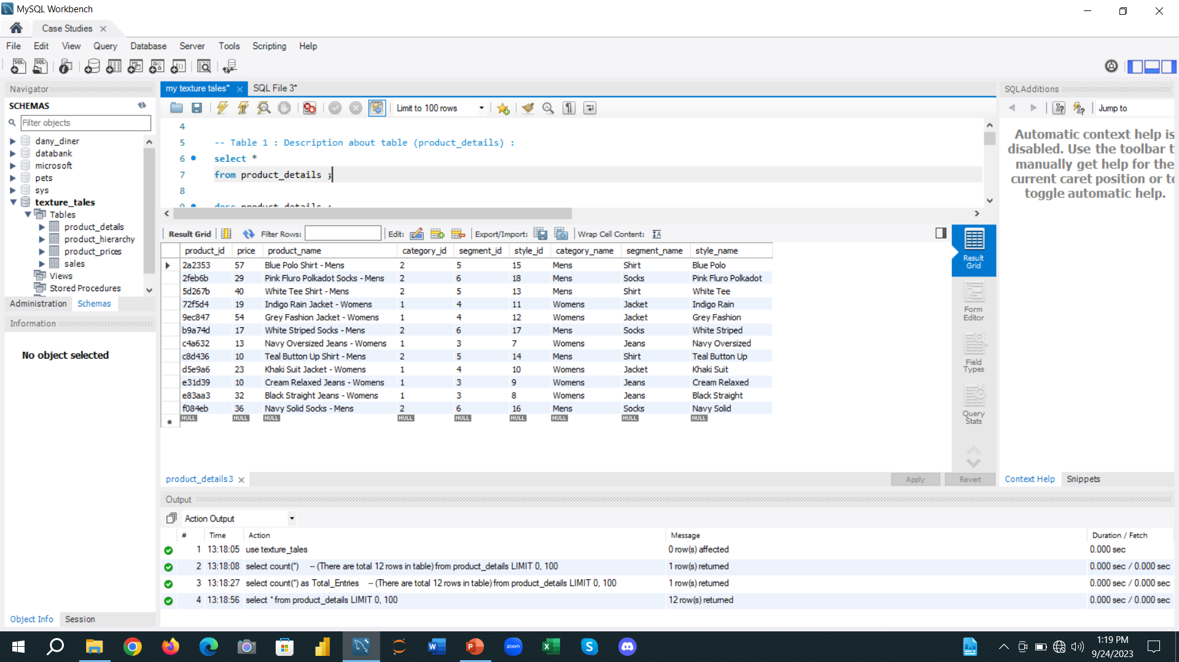
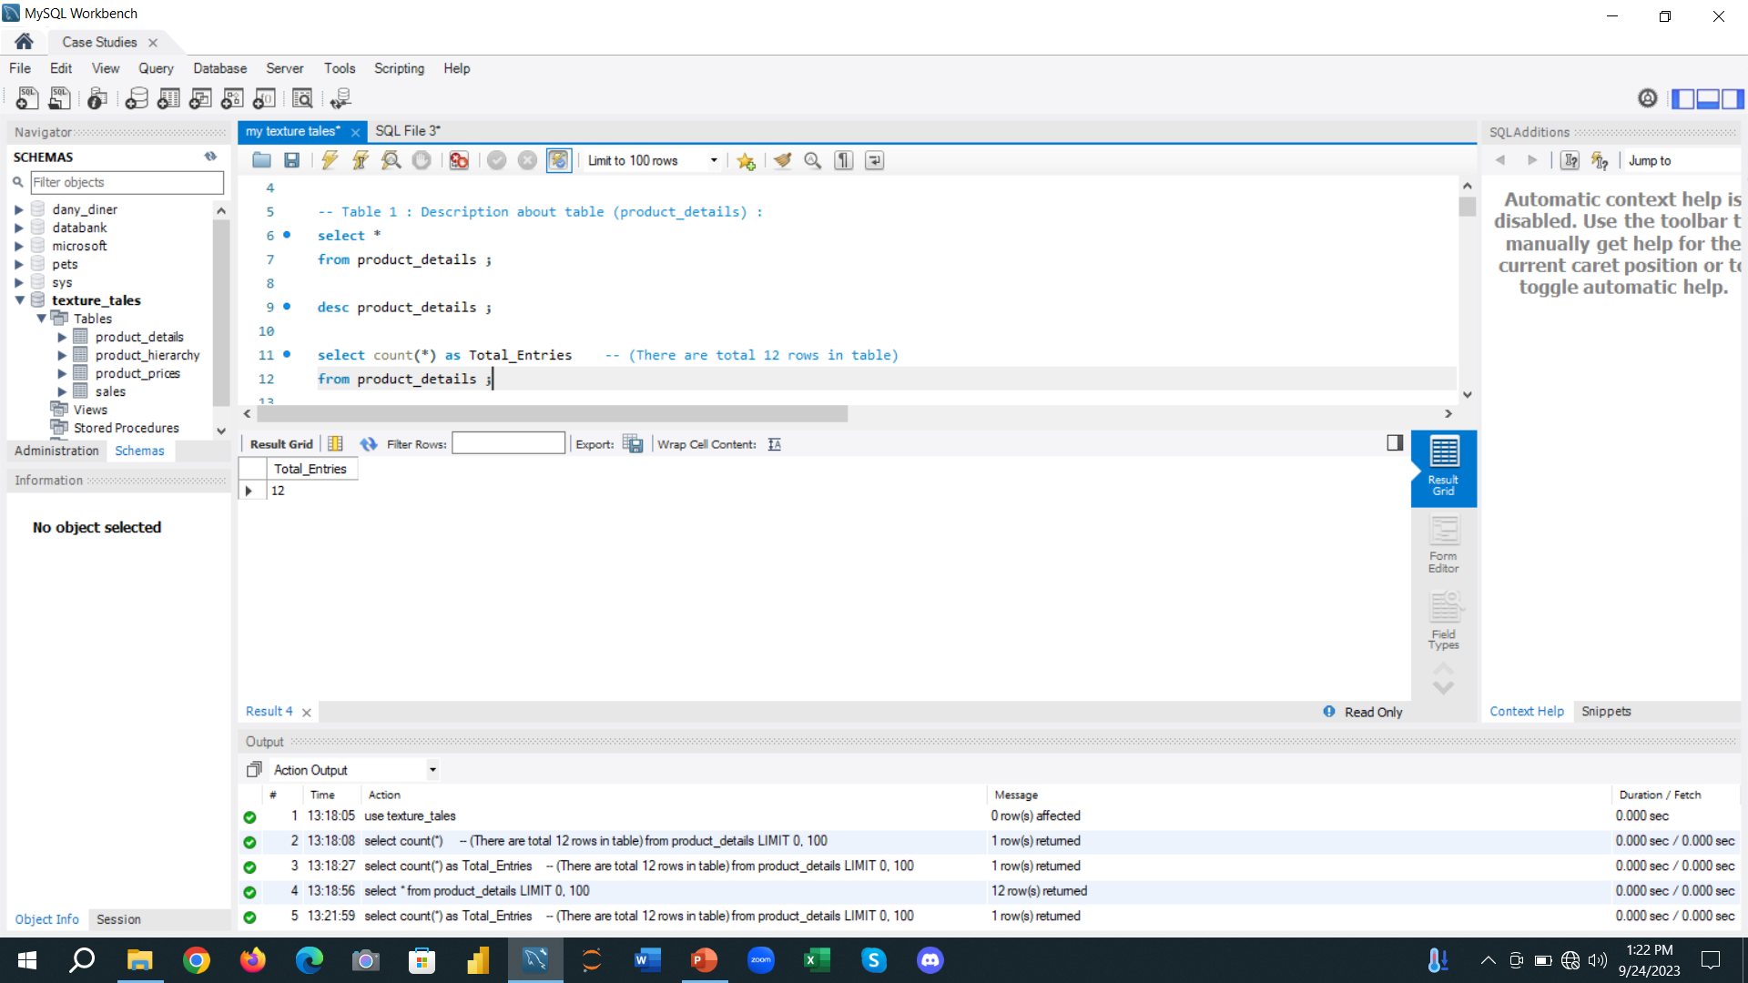
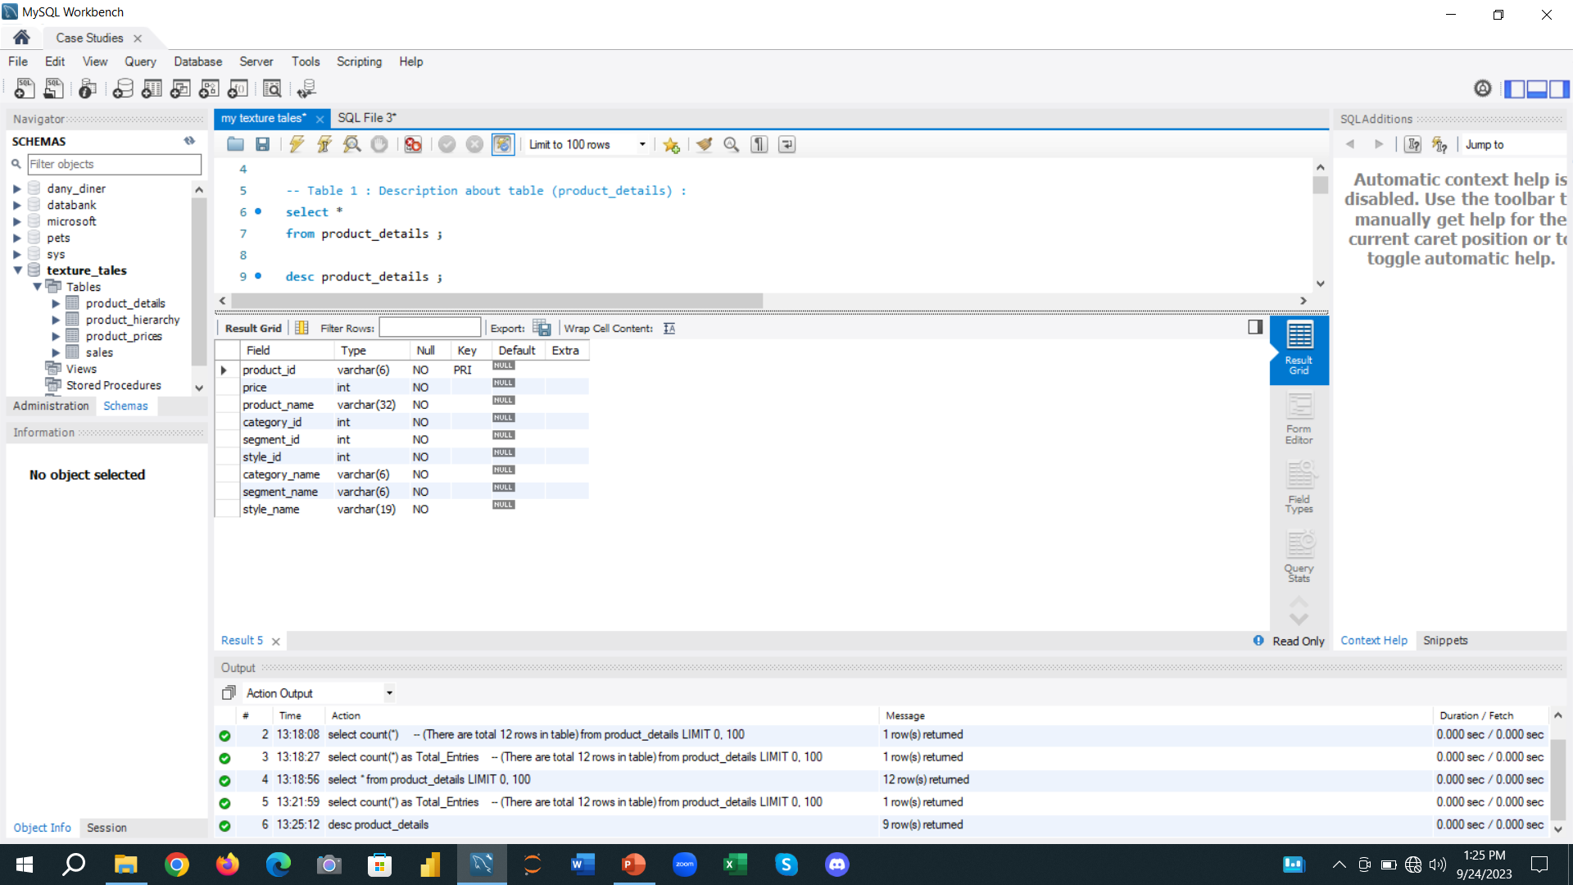
Details of Product_Details table
Product_Details table
There are total 12 entries in Product_details table
Columns description in Product_details table

Slide 5
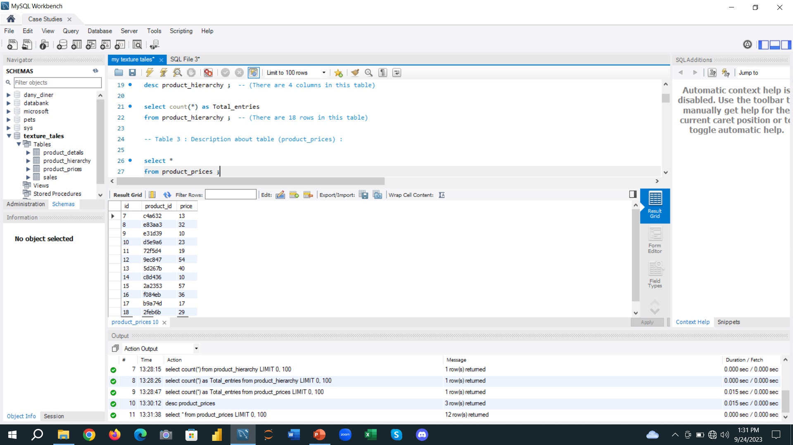
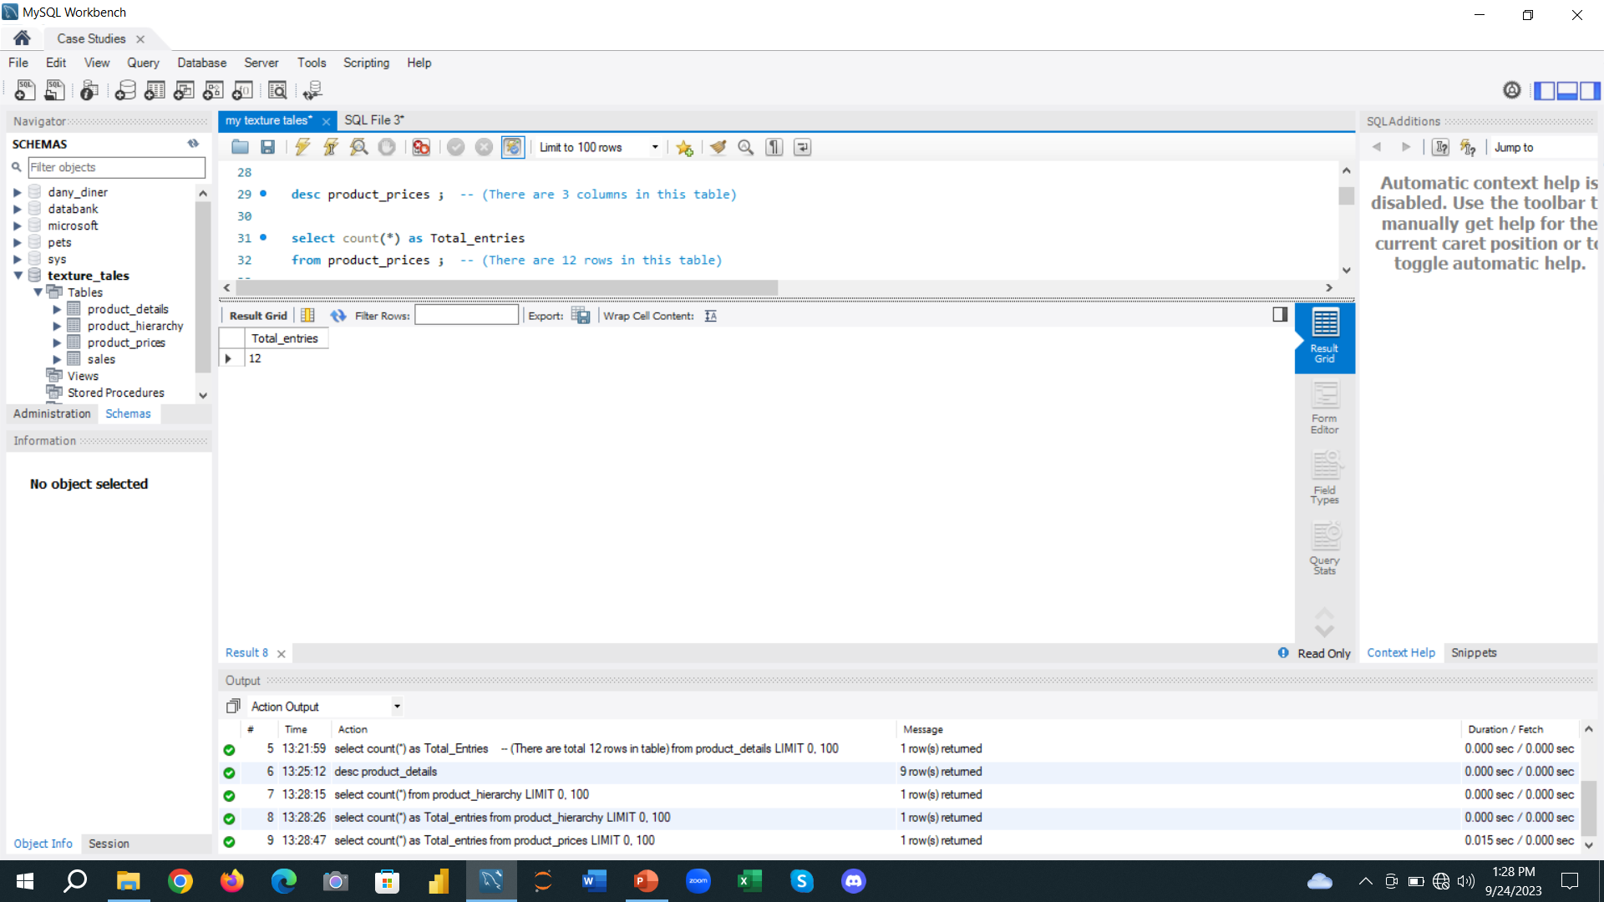
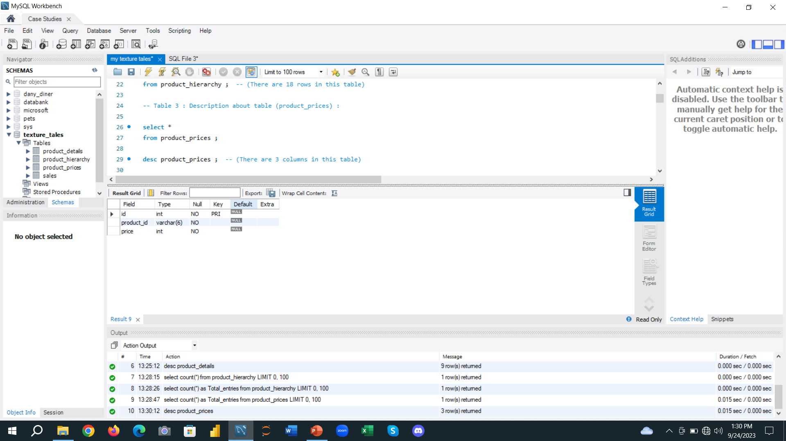
Details of Product_Prices table
Product_Prices table
There are total 12 entries in Product_Prices table
Columns description in Product_Prices table

Slide 6
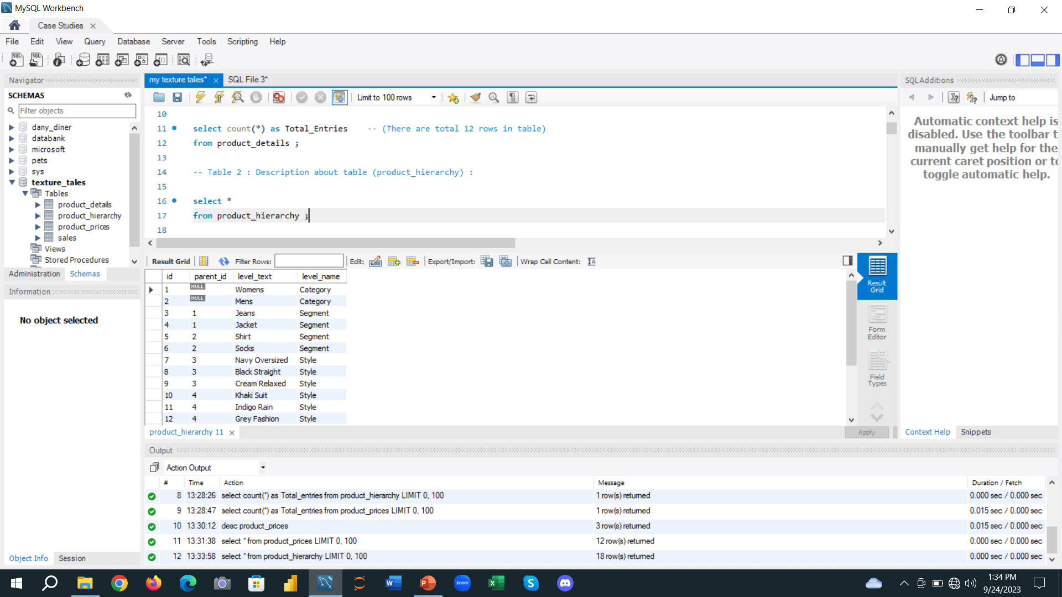
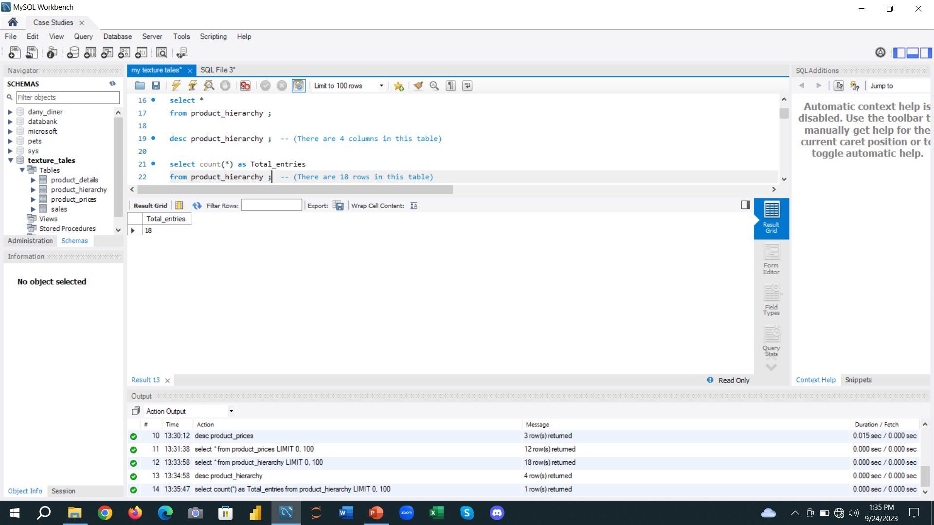
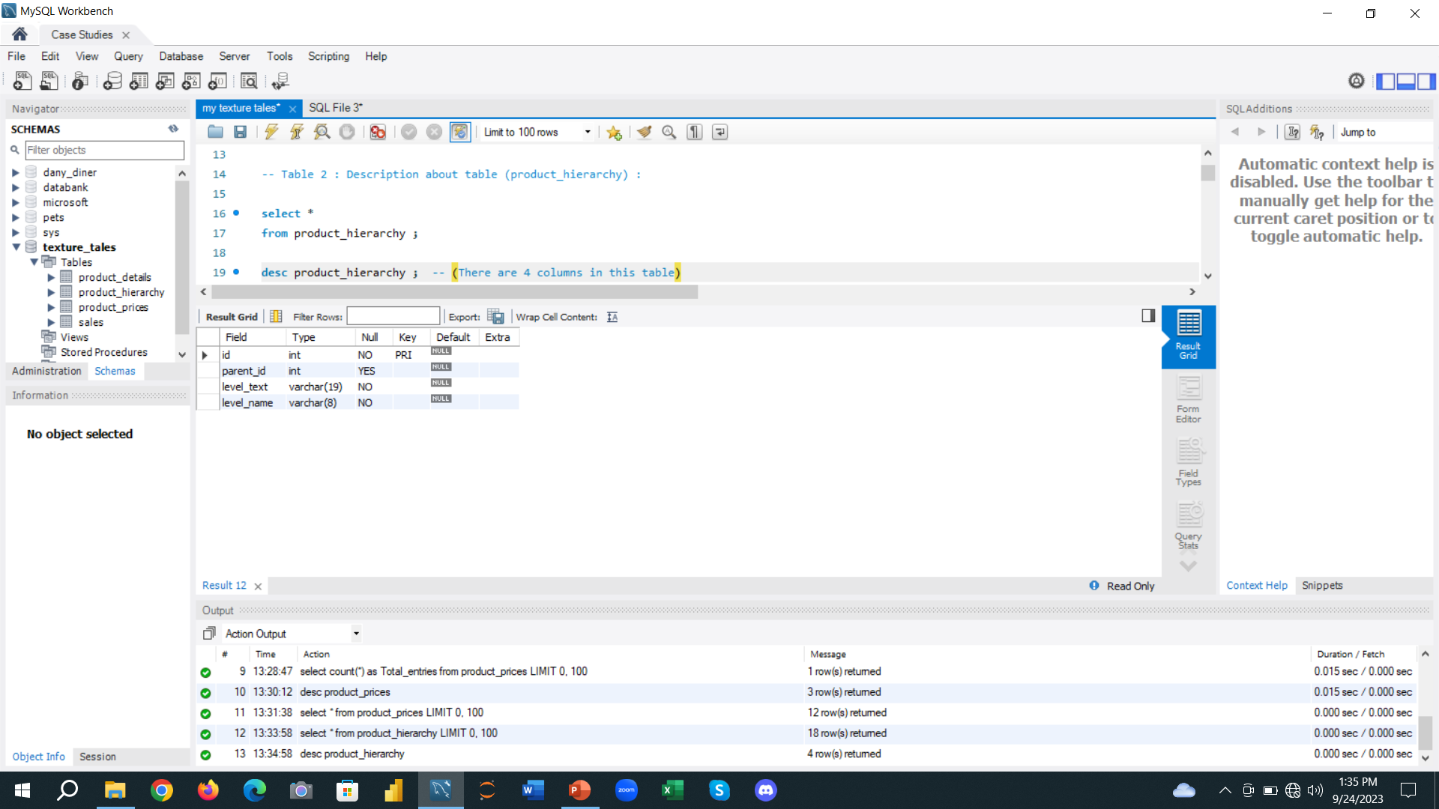
Details of Product_Hierarchy table
Product_Hierarchy table
There are total 18 entries in Product_Hierarchy table table
Columns description in Product_Hierarchy table

Slide 7
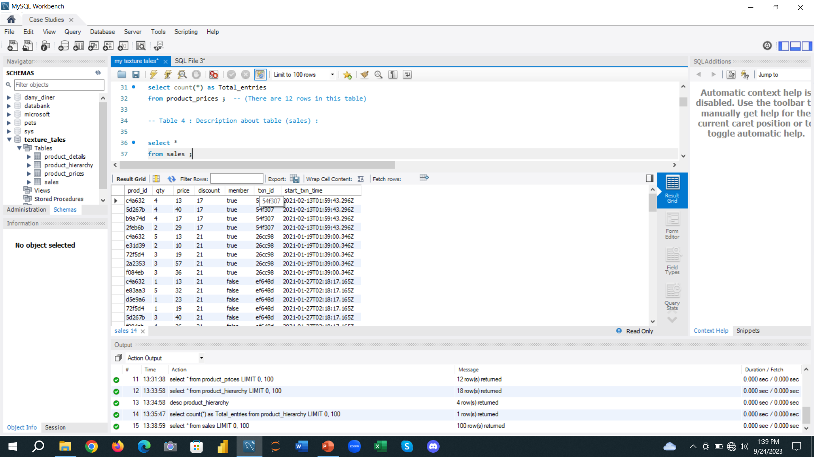

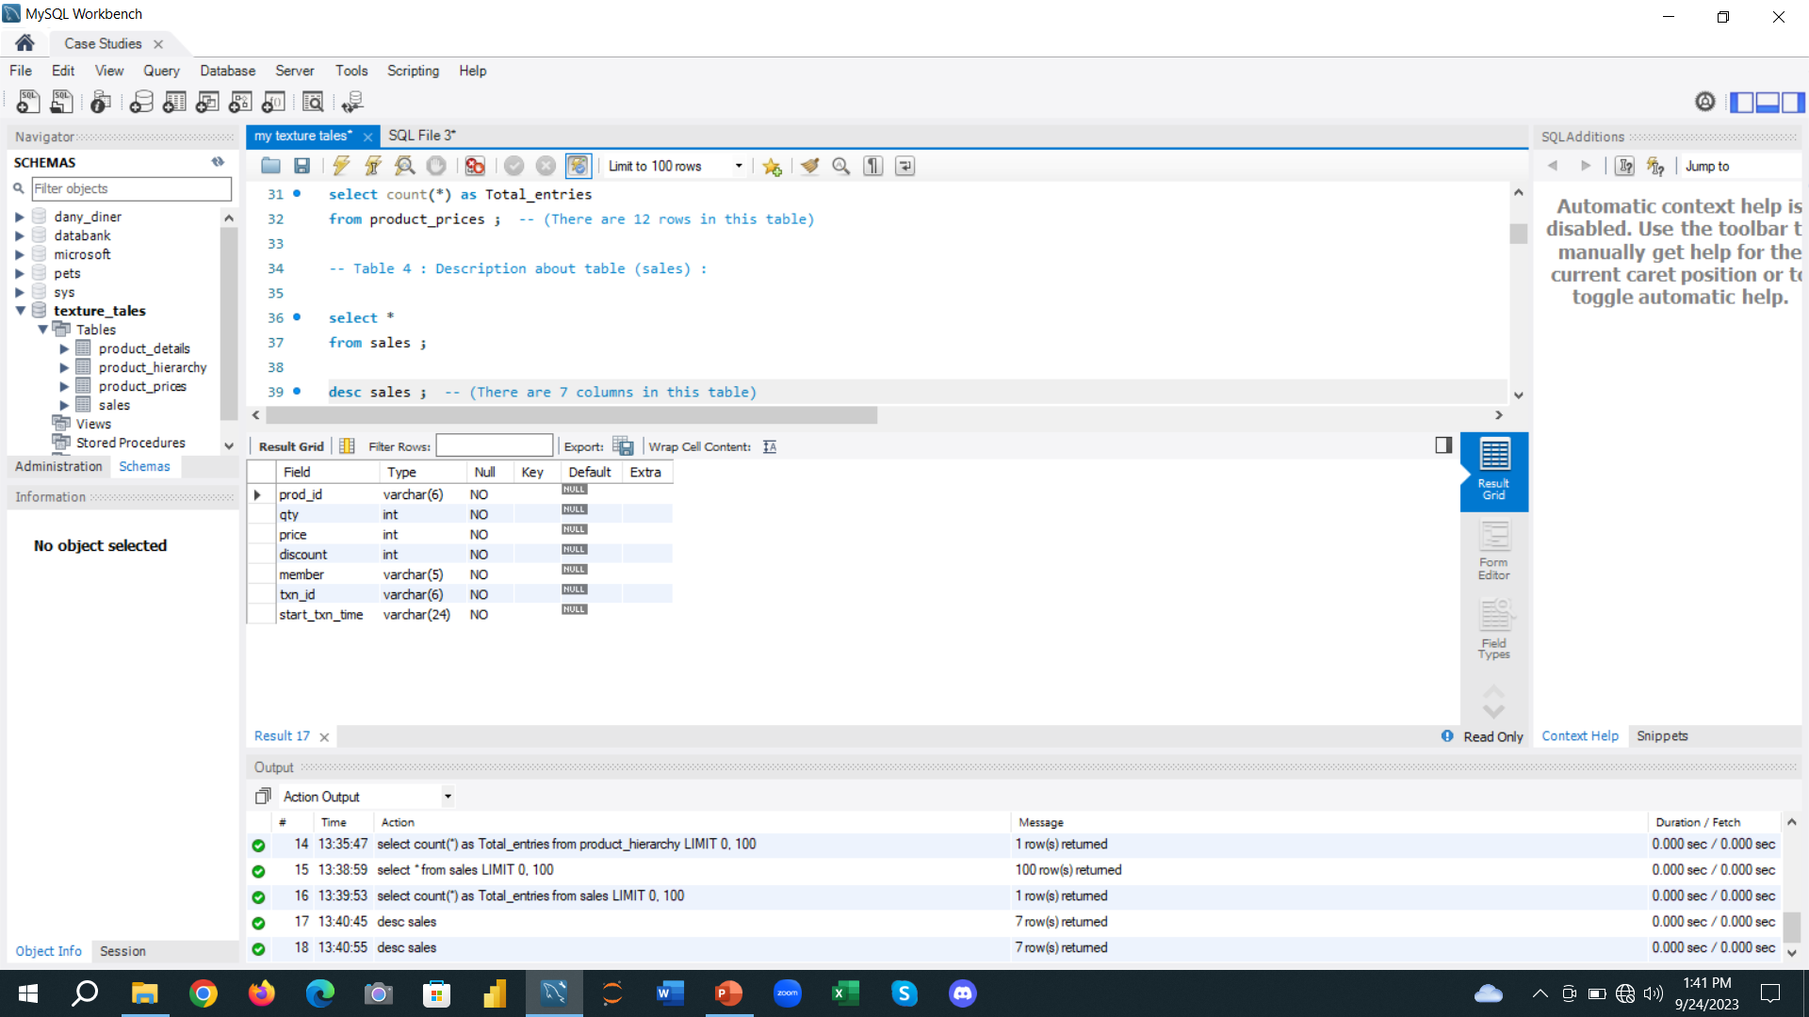
Details of Sales table
Sales table
There are total 15,095 entries in Sales table
Columns description in Sales table

Slide 8
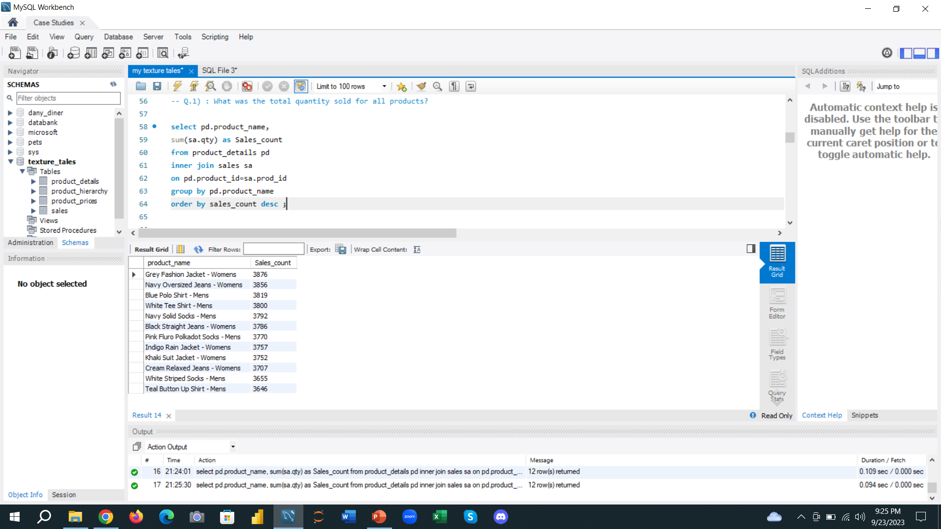
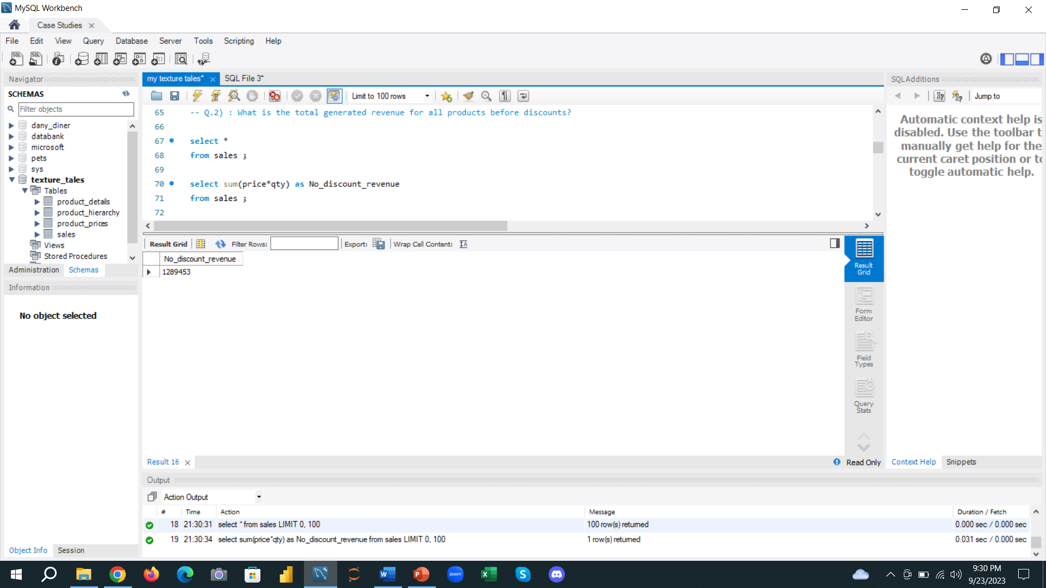
Analysis
1) What was the total quantity sold for all products?
2) What is the total generated revenue for all products before discounts?

Slide 9
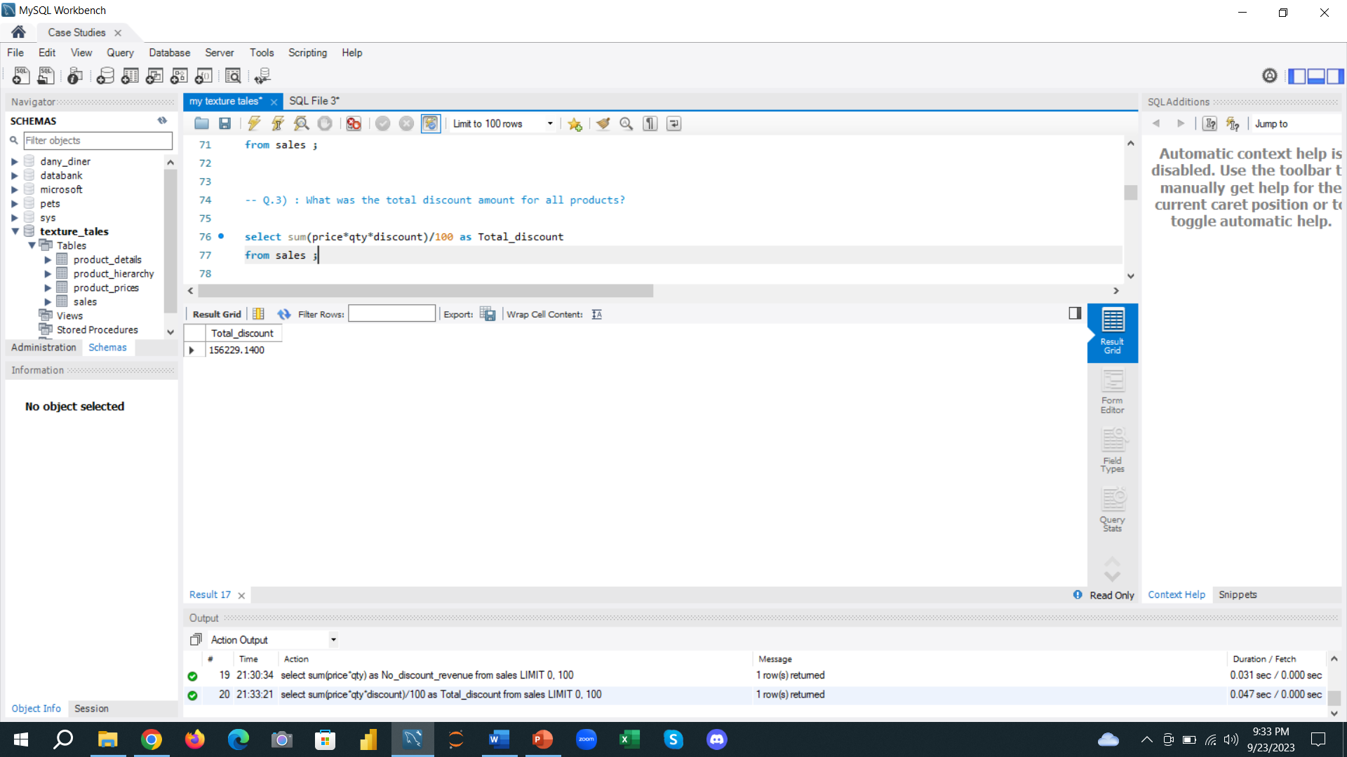
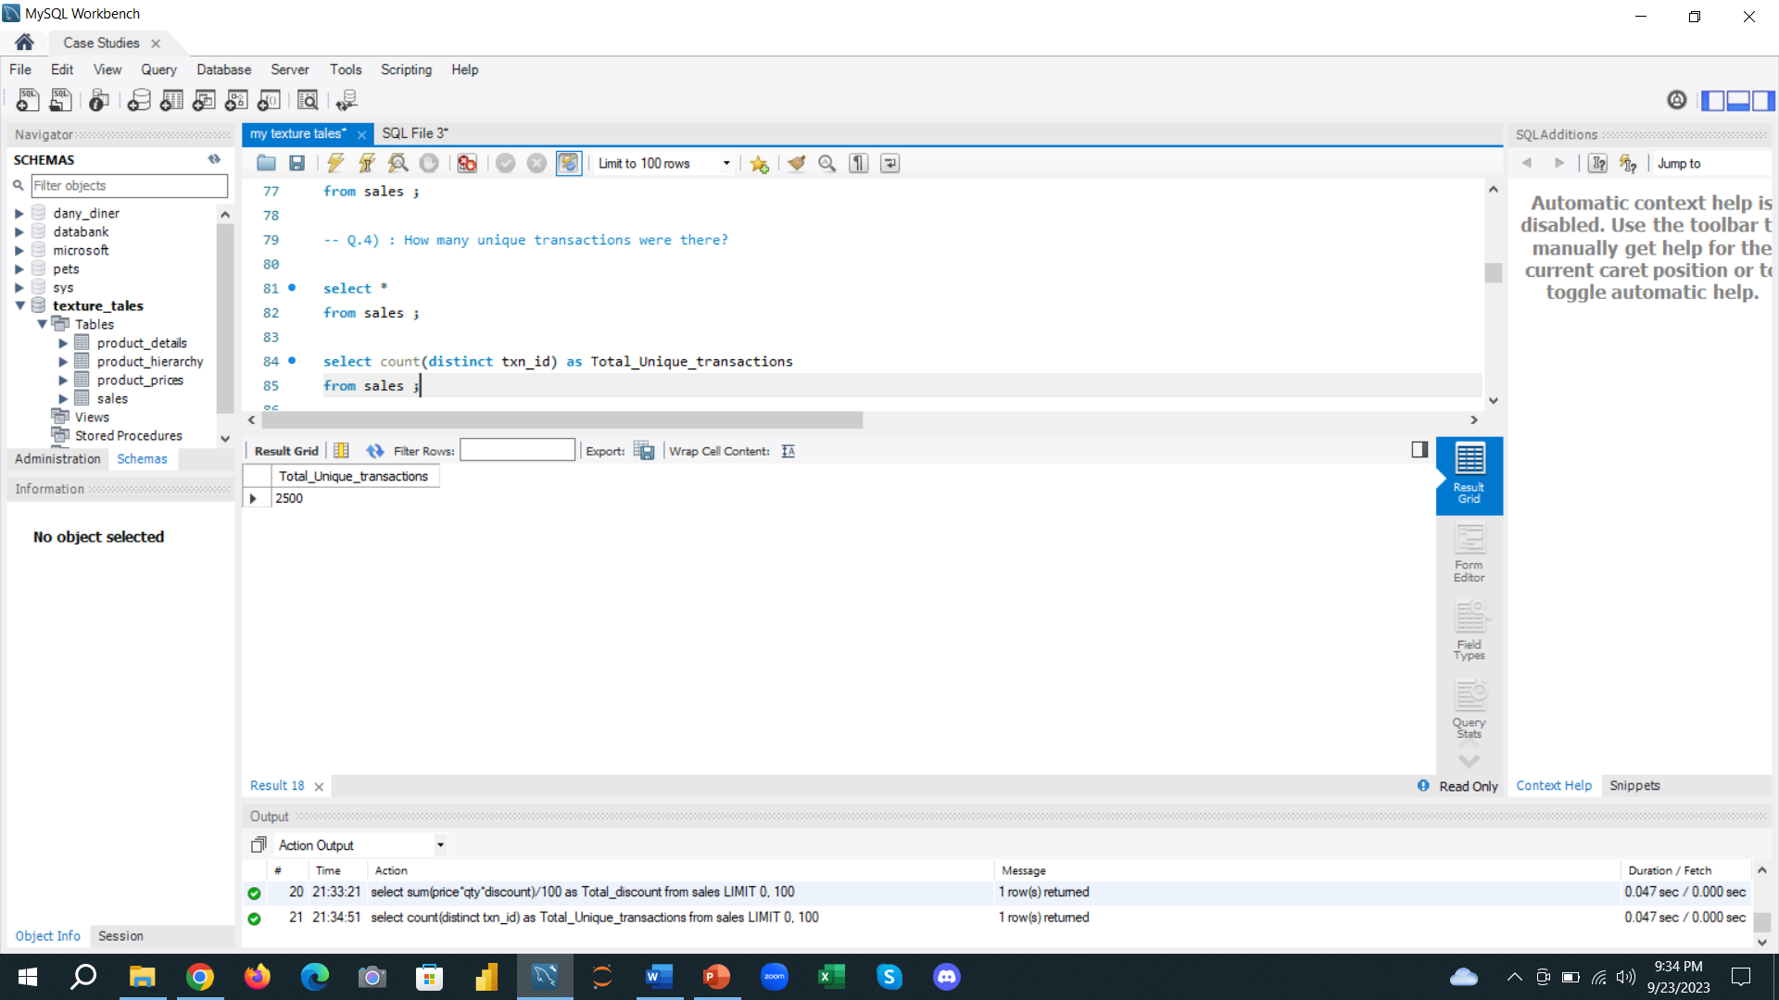
Analysis
3) What was the total discount amount for all products?
4) How many unique transactions were there?

Slide 10
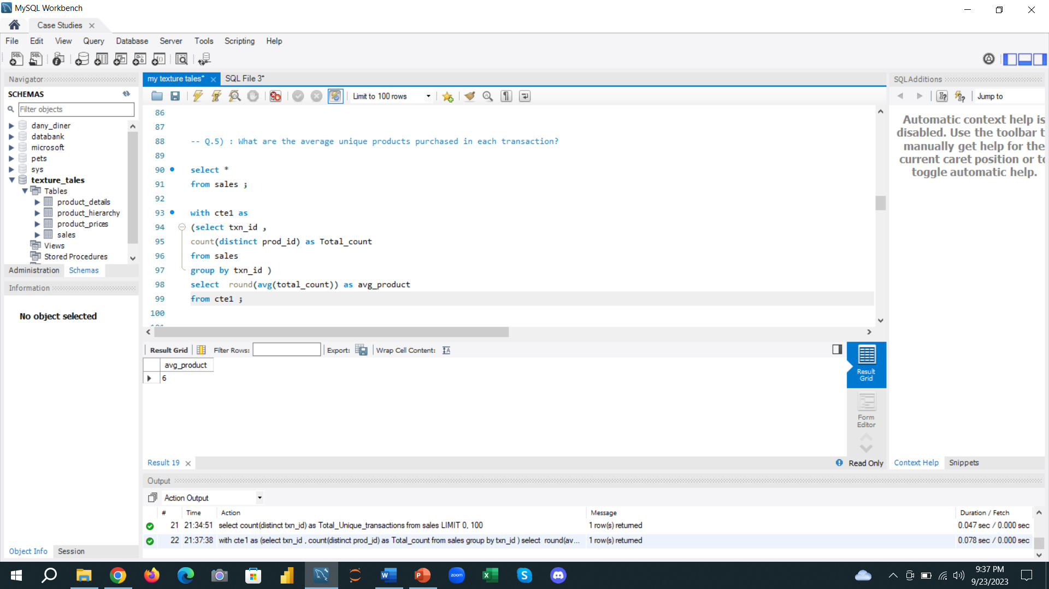
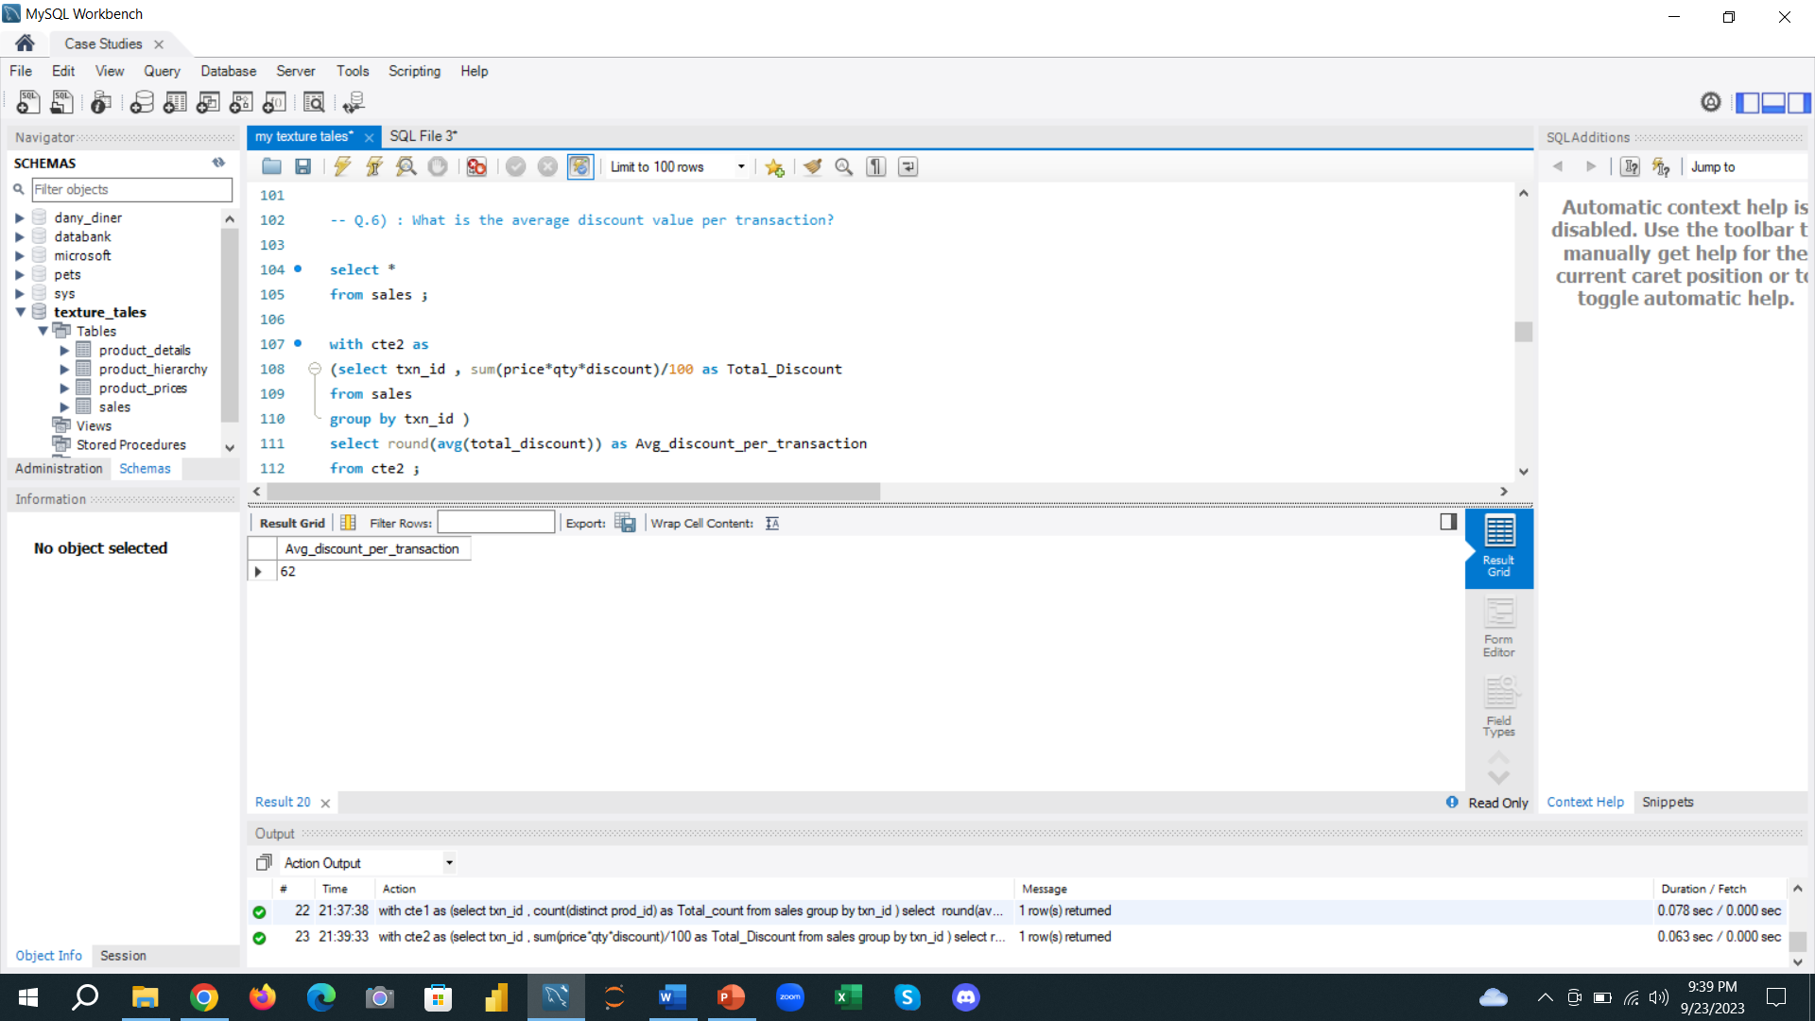
Analysis
5) What are the average unique products purchased in each transaction?
6) What is the average discount value per transaction?

Slide 11
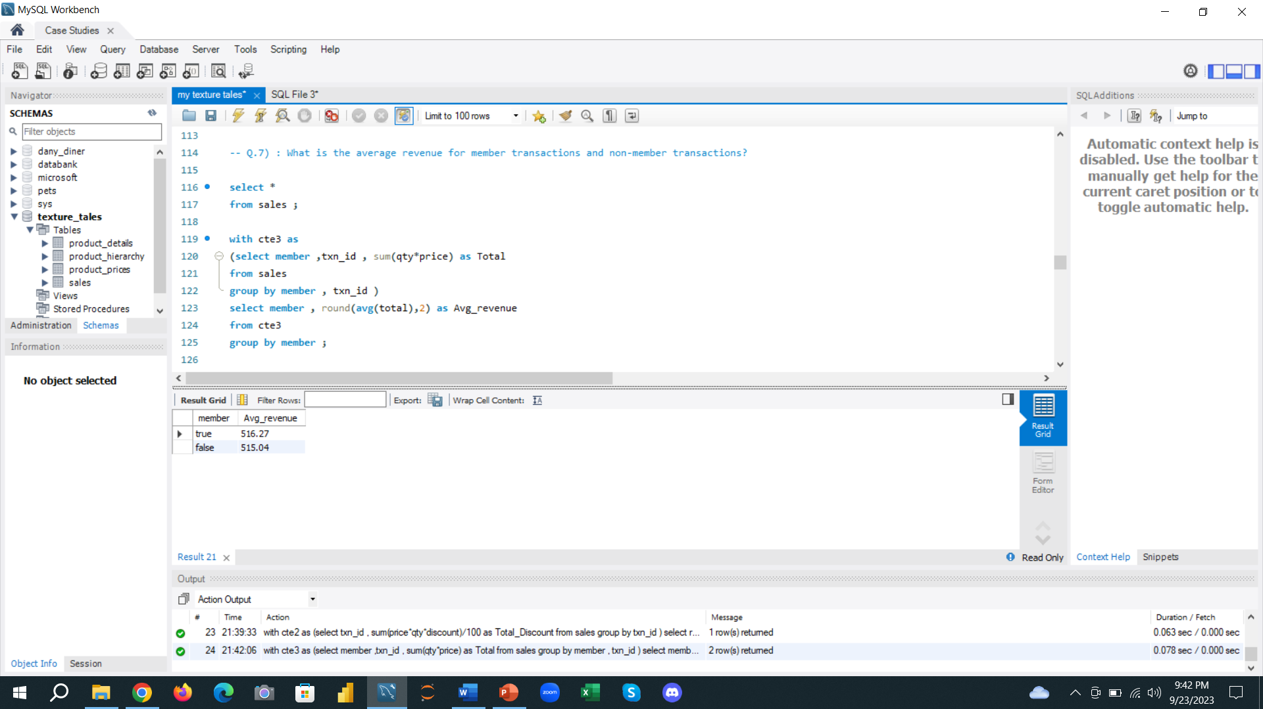
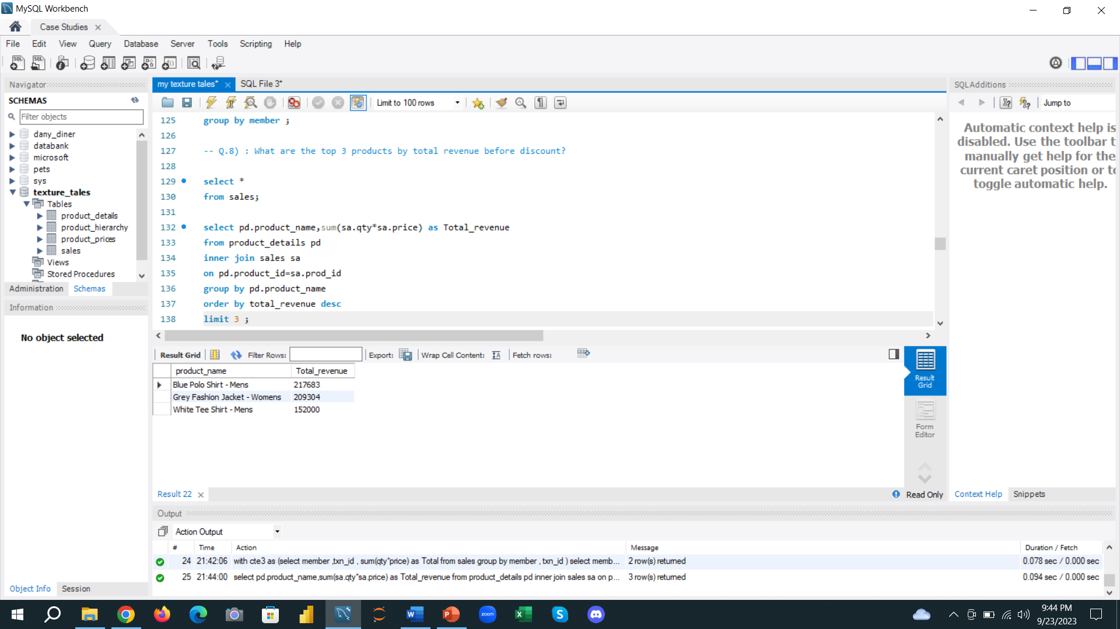
Analysis
7) What is the average revenue for member transactions and non-member transactions?
8) What are the top 3 products by total revenue before discount?

Slide 12
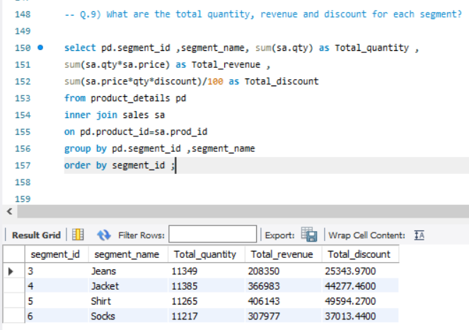
Analysis
9) What are the total quantity, revenue and discount for each segment?

Slide 13
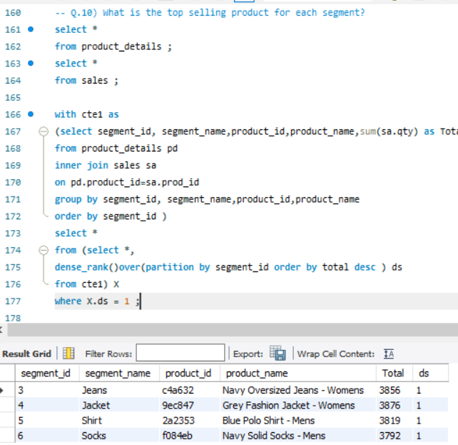
Analysis
10) What is the top selling product for each segment?

Slide 14
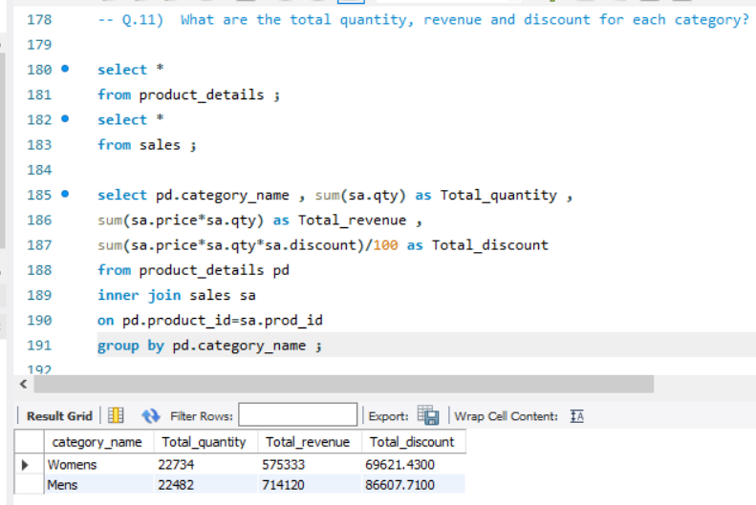
Analysis
11) What are the total quantity, revenue and discount for each category?

Slide 15
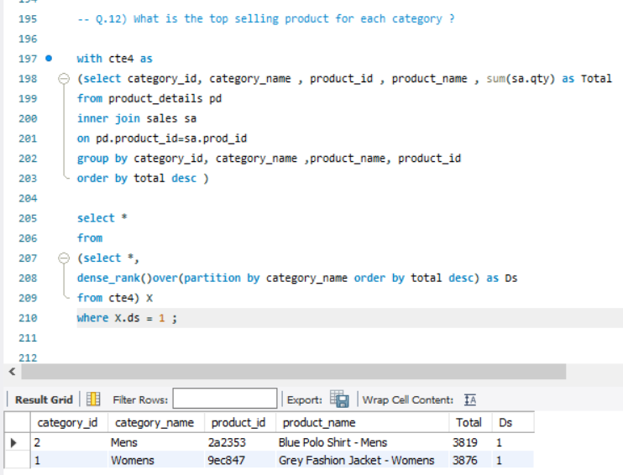
Analysis
12) What is the top selling product for each category?

